Slide 1

ECG Interpreter
 | Agnel Charities’ Fr. C. Rodrigues Institute of Technology, Vashi, Navi-Mumbai Department of Computer Engineering
Major Project 2023-24
Group No: 7B

Slide 2
Group Members:
 | Agnel Charities’ Fr. C. Rodrigues Institute of Technology, Vashi, Navi-Mumbai Department of Computer Engineering
Major Project 2023-24
Vasundhara Nimbalkar 1020220
Juhi Ramod 1020234
Rajit Shetty 1020245
Pratik Shrivastav 1020247

Slide 3
Outline
Problem Statement
Introduction
Literature Survey
Scope of the project
H/w and S/w Requirement
Timeline Chart
Conclusion

Slide 4

Problem Statement
This project aims to contribute to the field of medical diagnostics by providing an efficient and user-friendly ECG interpreter tool/system for Android OS.
The tool has the potential to assist individuals in gaining insights into their ECG results and raising awareness about potential cardiac abnormalities, thus promoting early detection and intervention for improved cardiac health.

Slide 5
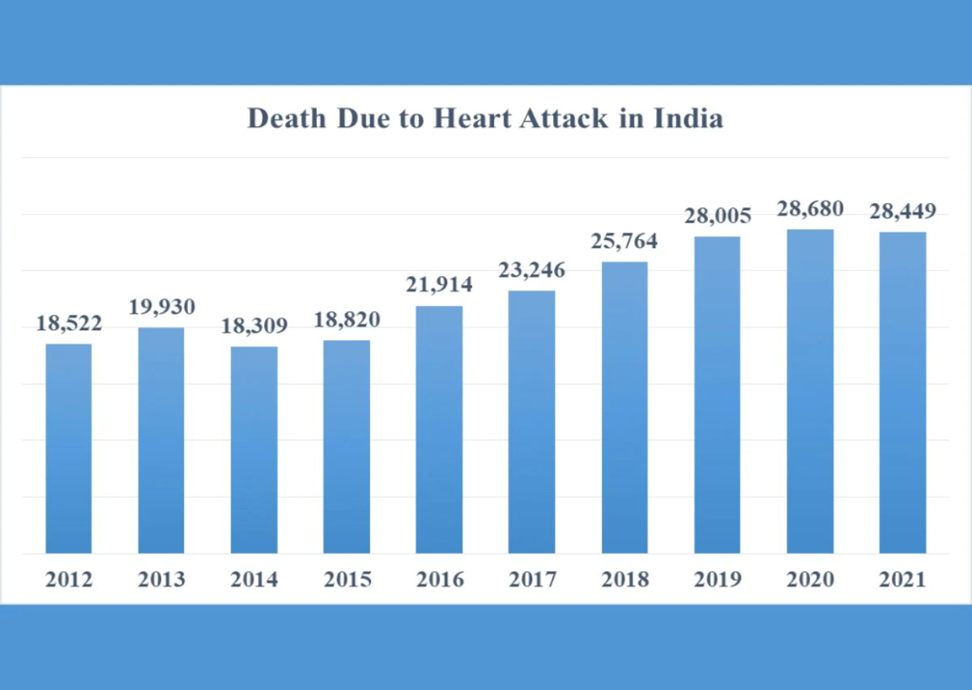
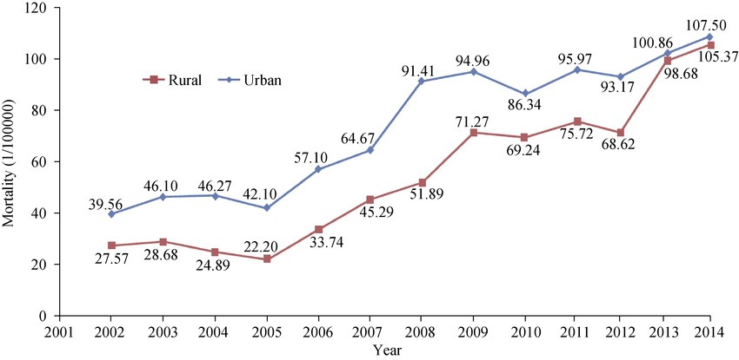
Introduction
Motivation
The increasing prevalence of cardiovascular diseases has underscored the importance of early detection and timely intervention.
Understanding the intricate details of ECG results can be challenging for laypeople, often leading to a lack of awareness and delayed medical intervention.

Slide 6
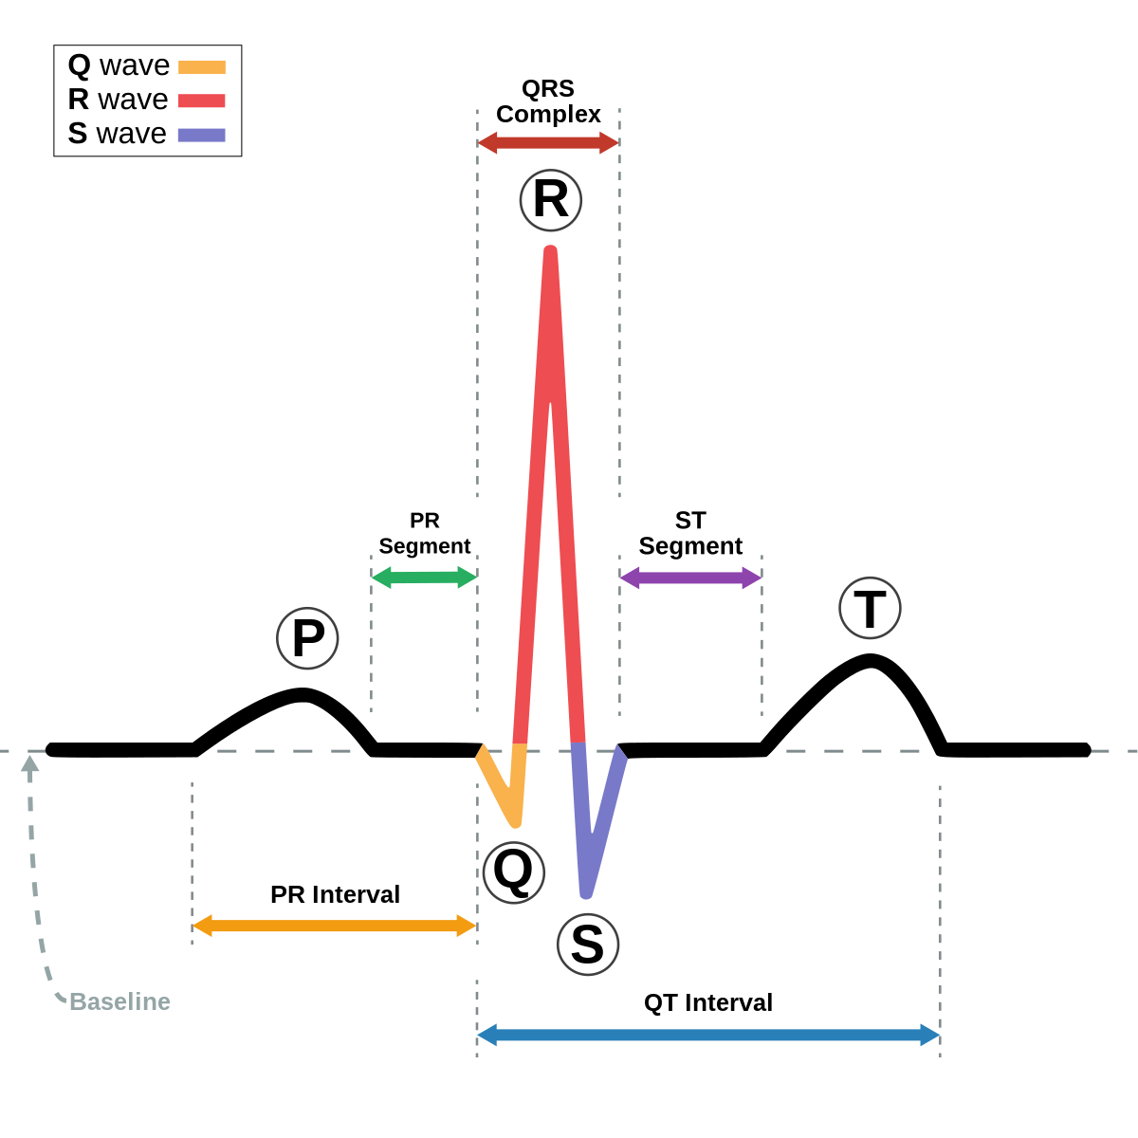
Introduction
Background:
The electrocardiogram has been extensively used in clinical medicine for more than 80 years, and is now a primary diagnostic tool for many cardiac and other diseases (Fisch, 2000; Van Mieghem, Sabbe, & Knockaert, 2004).
This machine aimed to assist in the diagnosis of arrhythmias.
It extracts important features such as the P, QRS, and T waves, heart rate, and intervals between waves.
These features are then used to identify potential cardiac issues, such as arrhythmias, heart attacks, and other abnormalities in heart rhythm or conduction

Slide 7
Introduction
Objective:
The main objective of this project is the integration of the developed ECG interpreter tool into an Android application/ or web based interface.
The user-friendly interface allows individuals to effortlessly capture their ECG images and receive instant interpretations in straightforward medical terms.

Slide 8
Literature Survey
Sr No. | Research Paper | Author | Technique used | Dataset/ Results | Advantages | Drawback
1 | Machine Learning Techniques Applied to Data Analysis and Anomaly Detection in ECG Signals: | Tomasz Andrysiak | QRS detection using a unidirectional, multidimensional neural network with backpropagation of an error | MIT-BIH Arrhythmia Database . proposed method shows promise for noninvasive diagnostic methods for rapid and objective determination of vital signs | Shows promise for non-invasive diagnostic methods for rapid and objective determination of vital signs. | Effectiveness of the method was tested using a specific database of ECG signals, and its performance may vary when applied to other datasets or in real-world clinical settings.

Slide 9
Literature Survey
Sr No. | Research Paper | Author | Technique used | Dataset/ Results | Advantage | Drawback
2 | A review on deep learning methods for ECG arrhythmia classification: | Zahra Ebrahimi , Mohammad Loni , Masoud Daneshtalabb, Arash Gharehbaghi | DNN,RNN,LSTM,GRU | The GRU/LSTM, CNN, and LSTM, showed outstanding results for correct classification of Atrial Fibrillation, Supraventricular Ectopic Beats, and Ventricular Ectopic Beats, respectively | Techniques used in the outstanding studies regarding the highest reported accuracy on ECG-based arrhythmia diagnosis. | The paper only focuses on the classification of a limited number of arrhythmias, and further research may be needed to evaluate the performance of DL methods on a broader range of arrhythmias.

Slide 10
Literature Survey
Sr No. | Research Paper | Author | Technique used | Dataset/ Results | Advantages | Drawback
3 | An Outlier Detection and Feature Ranking based Ensemble Learning for ECG Analysis: | Venkata Anuhya Ardeti, Venkata Ratnam Kolluru, Rajesh Kumar Patjoshi, George Tom Varghese | Optimized random forest (ORF) classifier | An improved IIQR filtering method and kernel-based feature selection approach for feature ranking and outlier detection. | paper also uses a kernel-based feature selection approach to find the ranks of the features. | Does not provide any information about the computational complexity of the proposed method, which may be a concern in real-time applications.

Slide 11
Literature Survey
Sr No. | Research Paper | Author | Technique used | Dataset/ Results | Advantages | Drawback
4. | ECG Monitoring Systems: Review, Architecture, Processes, and Key Challenges | Mohamed Adel Serhani , Hadeel T. El Kassabi , Heba Ismail and Alramzana Nujum Navaz | taxonomy consists of five clusters, each focusing on a specific dimension of ECG monitoring systems | Classify the performance-based systems into categories, considering the main factors affecting the performance, such as energy, cost and resource provision. | Expert-verified taxonomy of ECG monitoring systems, a generic architectural model, and a comprehensive set of processes to better understand, analyse, design, and validate these systems. | Lacks research focus on real-time processing using cloud resources, seamless information integration with sensors and networks, and IoT infrastructure for remote monitoring and smart home systems.

Slide 12
Literature Survey
Sr No. | Research Paper | Author | Technique used | Dataset/ Results | Advantages | Drawback
5 | Deep learning for comprehensive ECG annotation | Benjamin A. Teplitzky, PhD, Michael McRoberts, MS,Hamid Ghanbari, MD, FHRS | Deep learning model classification results were used to generate contiguous annotation results, and performance was assessed in accordance with the EC57 standard. | Deidentified ECG recordings from the single-channel Preventice BodyGuardian O Heart ambulatory patch-style monitor | By leveraging deep learning models and high-quality training data, the BeatLogic platform offers improved accuracy and reliability in ECG interpretation | Study failed to consider factors like diagnosis, medication, body mass index, and activity level to measure algorithm performance

Slide 13
Literature Survey
Sr No. | Research Paper | Author | Technique used | Dataset/ Results | Advantages | Drawback
6 | Classification of ECG Heartbeat Arrhythmia: A Review | Jagadeeswara Rao Annam a , Srinivas Kalyanapu a , Sureshbabu Ch. a , Jayaprada Somalaa ,S. Bapi Raju | SVM, LDA, PNN, wavelet transform, hierarchical SVM, PSO neural network, and OPF. | Raw ECG signals from the Physio Bank repository and employ mathematical methodologies and machine learning techniques. | This research paper explores the use of computer-based automated classification for distinguishing between normal and abnormal heart conditions. | lacks empirical evidence, evaluation, and discussion of potential limitations, which may limit its practical applicability and generalizability.

Slide 14
Literature Survey
Sr No. | Research Paper | Author | Technique used | Dataset/ Results | Advantages | Drawback
7 | Artificial intelligence-enhanced electrocardiography in cardiovascular disease management | Konstantinos C. Siontis, Peter A. Noseworthy, Zachi I. Attia and Paul A. Friedman | clinical applications and datasets, including the Telehealth Network of Minas Gerais, Mayo Clinic, Geisinger, Huazhong University, and iRhythm Technologies.HMM and CNN | AI algorithms like AI-ECG have significant potential in cardiology to guide treatment decisions and diagnose conditions. These clinical validations are potentially linked to the EAGLE and BEAGLE trials. | The AI-ECG technologies integrate AI and ECG to enable rapid, point-of-care diagnoses, potentially improving clinical decision-making and patient outcomes. | Not provided specific details about the EAGLE and BEAGLE trials, including their design and outcomes.

Slide 15
Literature Survey
Sr No. | Research Paper | Author | Technique used | Dataset/ Results | Advantages | Drawback
8 | Classification of normal and abnormal ECG signals based on their PQRST intervals | Noman Naseer, Hammad Nazeer Department of Mechatronics Engineering Air University Islamabad, Pakistan | genetic algorithms for feature optimization,LDA, wavelet transform, support vector machine, mathematical morphology, neural networks, and chaos theory | MIT-BIH database used. Paper mentions that the current system was tested on 10 subjects, out of which 9 were healthy and 1 had a cardiac disease | LDA as a classifier allows for efficient and accurate classification of normal and abnormal heartbeats | limited sample size may introduce bias and affect the classification accuracies

Slide 16
Scope of the Project
The ECG interpretation system targets patients, healthcare professionals, and the general public for monitoring cardiac health, interpreting ECG results, and understanding cardiac health status. It provides a reliable tool for interpreting results and providing valuable insights into patients' and practitioners' health.
Functionalities:
Upload ECG Scans
ECG Analysis
Deep Learning and Machine Learning
Transfer Learning
Model Optimization
Plain-English Readings
Promotion of Cardiac Health
Early Detection and Intervention
Engineer and Society Consideration: yes
Development is environmental friendly and sustainable: yes

Slide 17
Hardware Requirement:
i5 Processor Based Computer or higher
Memory: 10 GB RAM
Hard Drive: 512 GB
Monitor
Software Requirement:
MATLAB Version R2013a,python
Operating system: Windows 7 and above

Slide 18
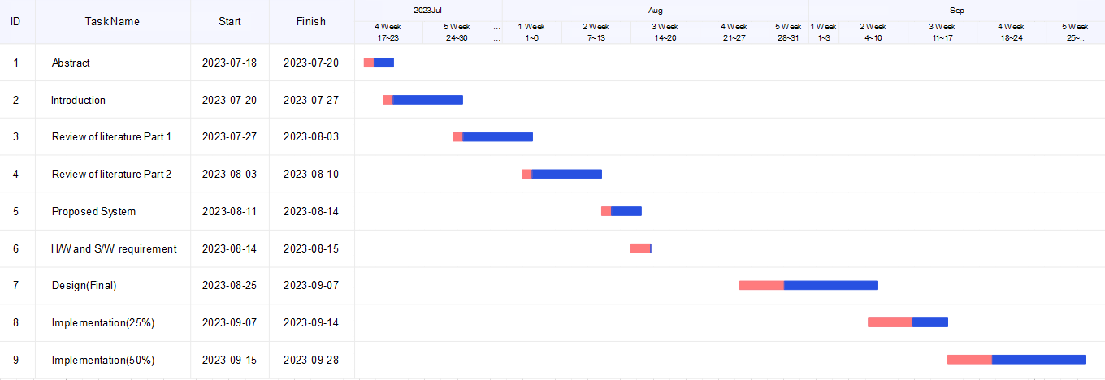
Timeline Chart

Slide 19
Team Contribution
Member Name | Work Done
Vasundhara Nimbalkar | Reasearch paper,Abstract,Introduction
Juhi Ramod | Reasearch paper,Abstract,Introduction
Rajit Shetty | Reasearch paper,proposed system,System requirements
Pratik Shrivastav | Reasearch paper,proposed system, System requirements

Slide 20

Conclusion
The project has made significant progress in the current phase, with research and analysis completing tasks such as gathering data and insights, and design and planning defining the scope, requirements, and architecture of the solution.
The team plans to focus on development, testing, and website/app development before the next presentation. We will use Recurrent Neural Networks and Convolutional Neural Networks models to build an efficient ECG system. Rigorous testing will identify and rectify bugs, ensuring higher reliability and performance. Once the model is fully trained, the team will proceed with website/app development for the ECG system.

Slide 21
References
Add papers details in IEEE format

